Slide 1


USING JAVA
Rachana Patel(104704646)
Charmi Shah(104705681)
Bansari Shah(104656282)
Shivani Vyas(104705401)
Instructor: Dr. Luise Rueda

Slide 2
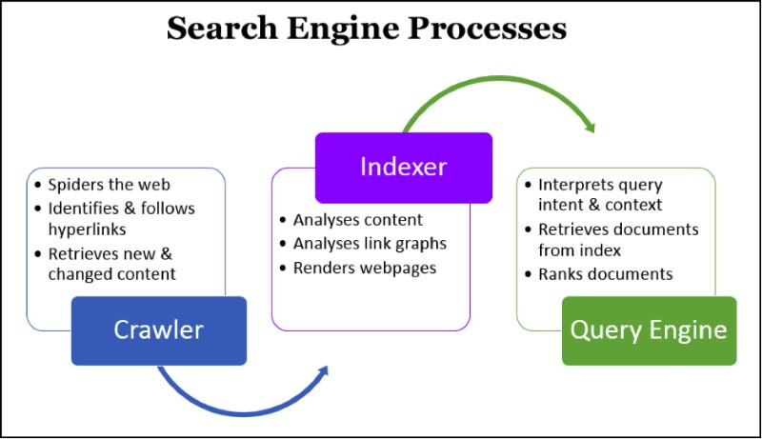
INTRODUCTION
Search engines are programs that search specified keywords entered by user
Returns a list of the keywords and give suggestions according to user’s input.

Slide 3

SEARCH ENGINES

Slide 4
FUNCTIONALITY
Finding the meaning of a word
Listing links from the URL
Indexing and searching
Check for mis-spelled words
Find Homophones for a word

Slide 5
CONCEPTS
Jsoup Converter
Dictionary check
Edit Distance
Hash Map
Index and search

Slide 6
Jsoup
Jsoup is a java library for working with real world HTML
Analyze and remove HTML tags from webpage and extract links from the file
When the user enters the URL then it will fetch the given web page and extract links ,images and other pointers.

Slide 7
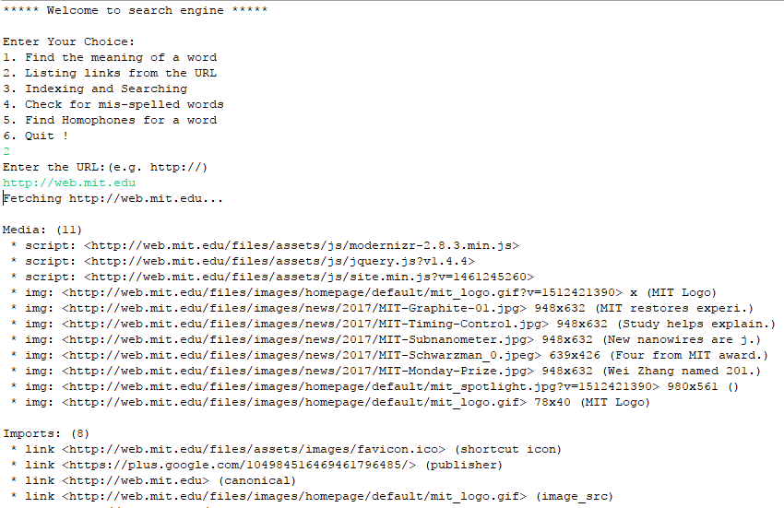
LISTING LINKS FROM URL

Slide 8
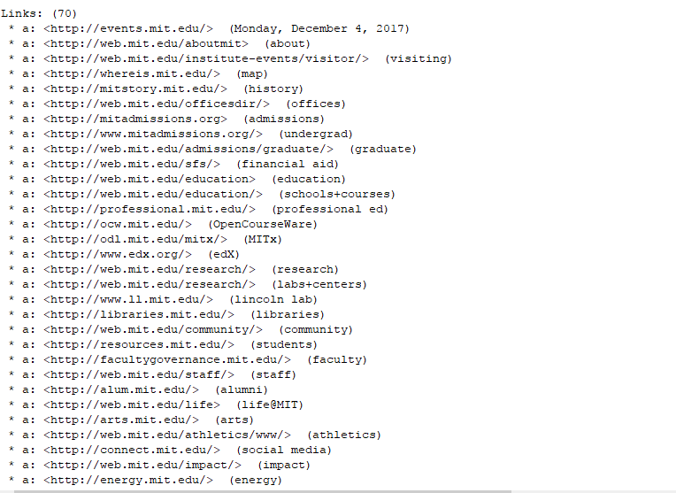
CONTI…

Slide 9
DICTIONARY CHECK
It tests whether the input word is present in the Dictionary or not.
This check should be case insensitive.
For example, if the Dictionary contains “feint" and we search for “find” then it will automatically search word related to find and give the meaning of that.

Slide 10
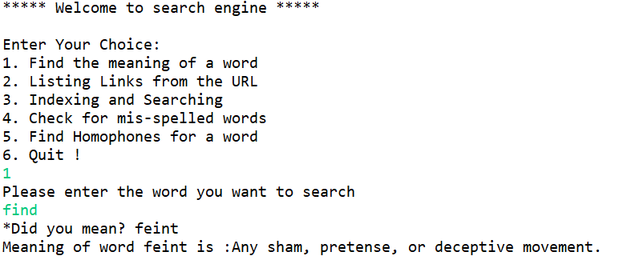
MEANING OF THE WORD

Slide 11
EDIT DISTANCE
Here, we use Levenshtein distance. The Levenshtein distance, alternatively known as the Edit distance
Spell Checkers – detecting spelling errors in text and find the closest correct spelling in dictionary
It also gives a suggestion of a word when searching a word
It reads from a dictionary file and print out any mis-spelled word that appear on standard input.

Slide 12
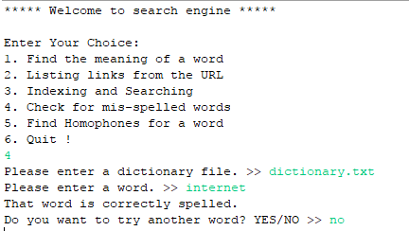
SPELL CHECKER

Slide 13
HASH TABLE
This class implements a hash table, which maps keys to values. Any non-null object can be used as a key or as a value
To successfully store and retrieve objects from a hash table
Uses hash function to compute an index into an array of buckets

Slide 14
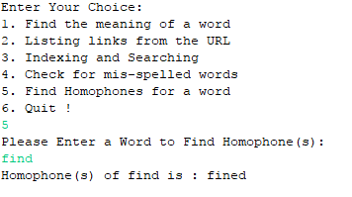
HOMOPHONES

Slide 15
INDEX AND SEARCH
To achieve fast search responses because, instead of searching the text directly, it searches an index instead.
This would be the equivalent of retrieving pages in a book related to a keyword by searching the index at the back of a book, as opposed to searching the words in each page of the book.

Slide 16
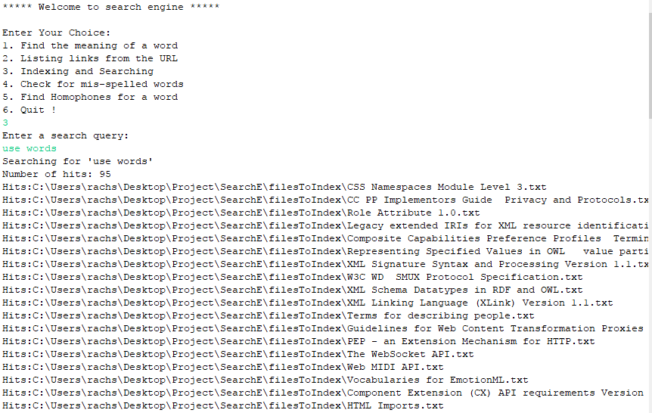
CREATING INDEX

Slide 17
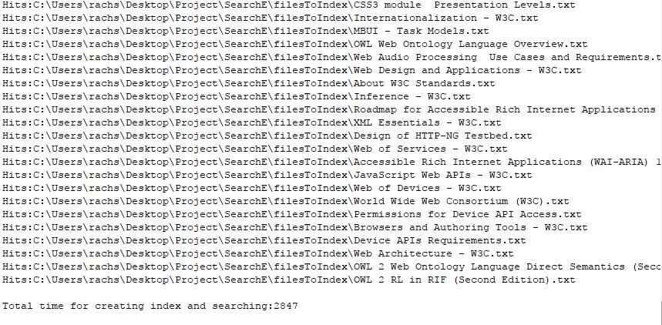
SEARCHING

Slide 18
Task Distribution
Rachana Patel: Indexing, Spell checker, List Links
Bansari Shah: List Links, Meaning of the word
Charmi Shah: Homophones, List links
Shivani Vyas: Homophones, Spell checker

Slide 19


